Slide 1
BrainSway
Group meeting – 2/1/18

Slide 2
2 Principal Electrodes – Time

Slide 3
2 Principal Electrodes – Frequency

Slide 4
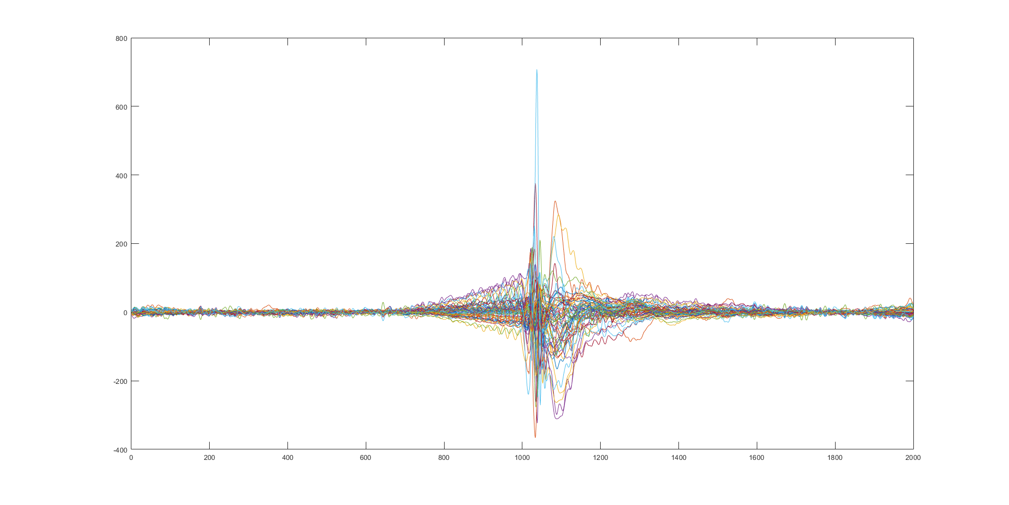
Average Signal In Time

Slide 5
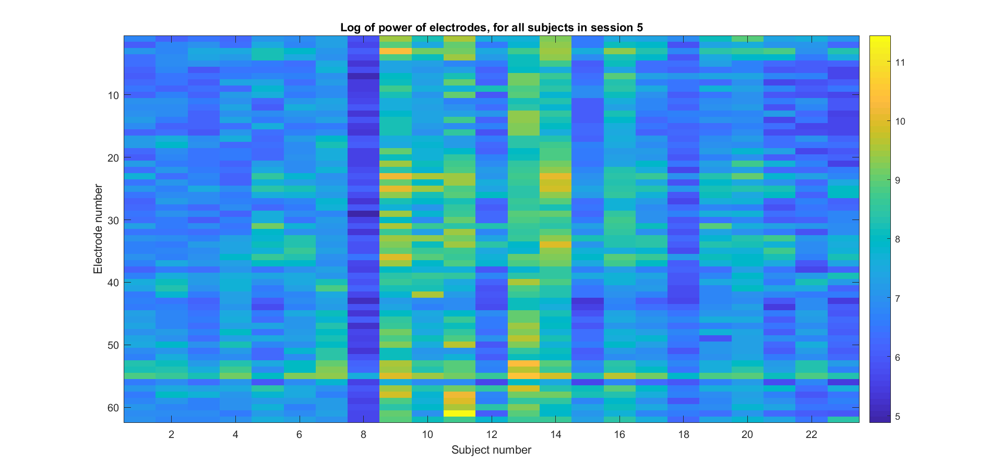
Variances of signals by subjects

Slide 6
Without the peak

